Slide 1
Educational scenario
Every year thousands of applications are being submitted by international students for admission in colleges of the USA. It becomes an iterative task for the Education Department to know the total number of applications received and then compare that data with the total number of applications successfully accepted and visas processed. Hence to make the entire process easy, the education department in the US analyze the factors that influence the admission of a student into colleges. The objective of this exercise is to analyze the same.

Slide 2
Objectives
Analysis Tasks:
Analyze the historical data and determine the key drivers for admission.
Predictive:
Find the missing values. (if any, perform missing value treatment)
Find outliers (if any, then perform outlier treatment)
Find the structure of the data set and if required, transform the numeric data type to factor and vice-versa.
Find whether the data is normally distributed or not. Use the plot to determine the same.
Normalize the data if not normally distributed.
Use variable reduction techniques to identify significant variables.
Run logistic model to determine the factors that influence the admission process of a student (Drop insignificant variables)
Calculate the accuracy of the model and run validation techniques.
Try other modeling techniques like decision tree and SVM and select a champion model
Determine the accuracy rates for each kind of model
Select the most accurate model
Identify other Machine learning or statistical techniques

Slide 3
Descriptive
Categorize the average of grade point into High, Medium, and Low (with admission probability percentages) and plot it on a point chart. Cross grid for admission variables with GRE Categorization is shown below:
GRE | Categorized
0-440 | Low
440-580 | Medium
580+ | High

Slide 4
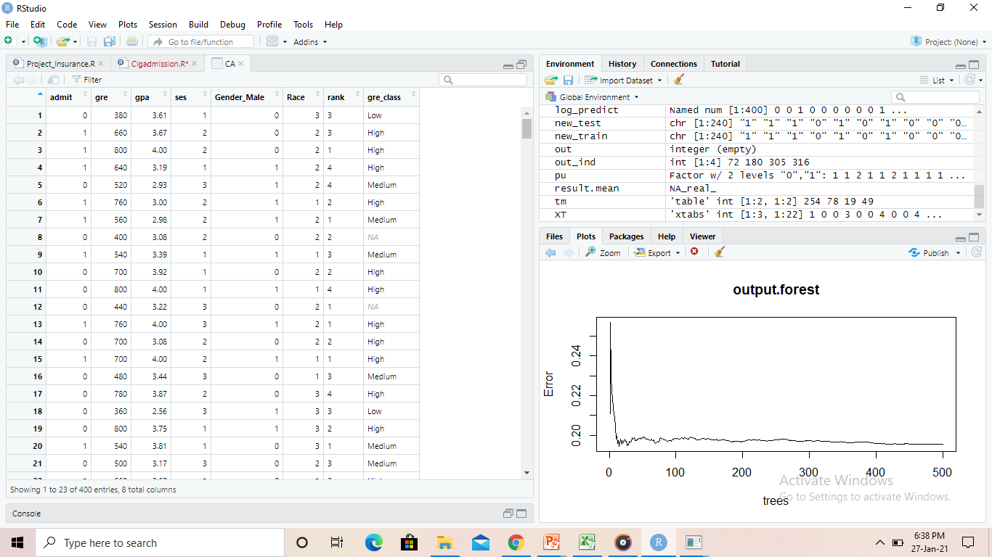
DataSet

Slide 5
Data Exploration
Load dataset.
Checking missing values.
Find structure of dataset.
Factoring.
Outliers detection using plots.
Normality Distribution test.
Reducing variables.

Slide 6
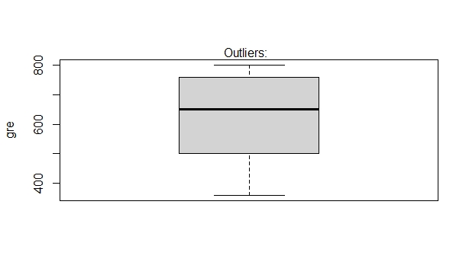
Outliers Plot

Slide 7
Linear Regression
Select best subset .
Variables selection based on its significance.
Stepwise forward regression is used to subset variables.
Based on that we get significant variables which affects on admission of students,
Rank and grad are most affecting variables.

Slide 8
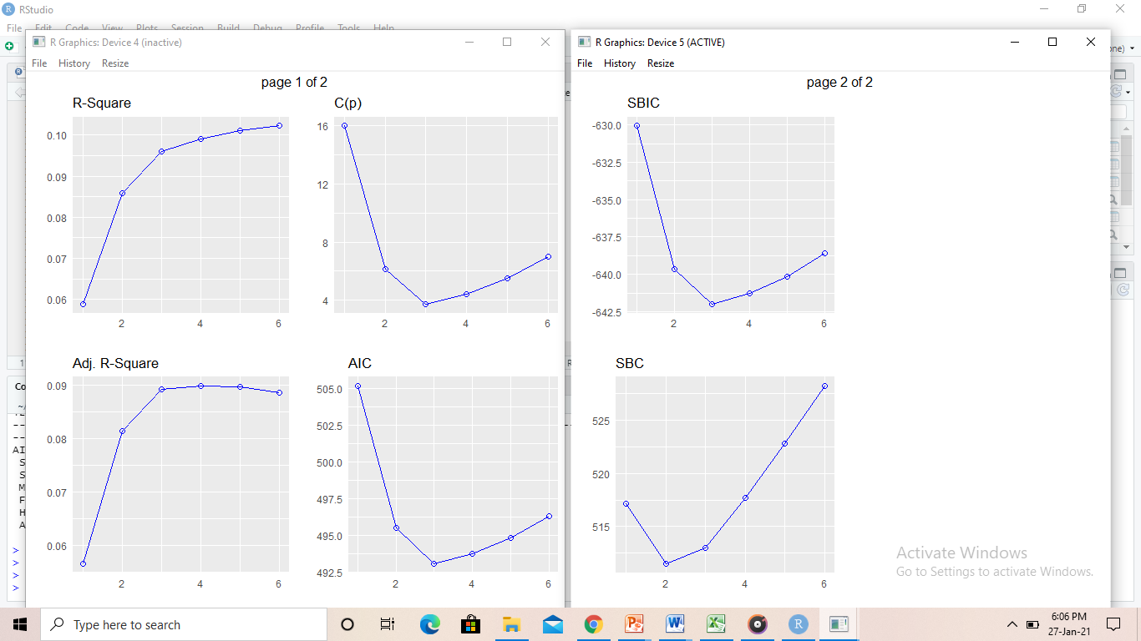
Plots of model

Slide 9
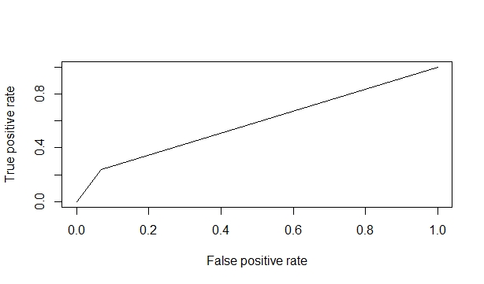
Logistic Regression

Slide 10
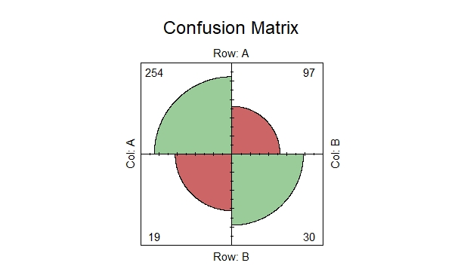
Confusion Matrix

Slide 11
Categorization of grad attribute
CA$gre_class n
1 Low 20
2 Medium 126
3 High 197
4 <NA> 57
>

Slide 12
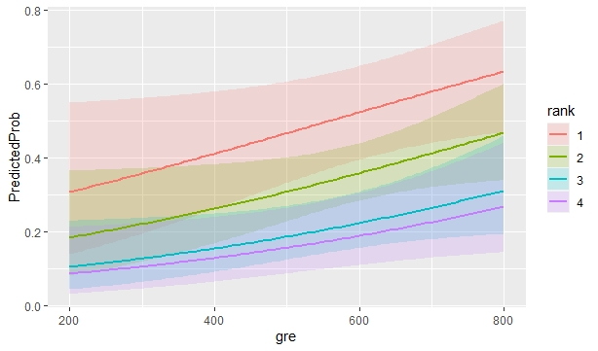
PredictedProb VS Gre graph

Slide 13
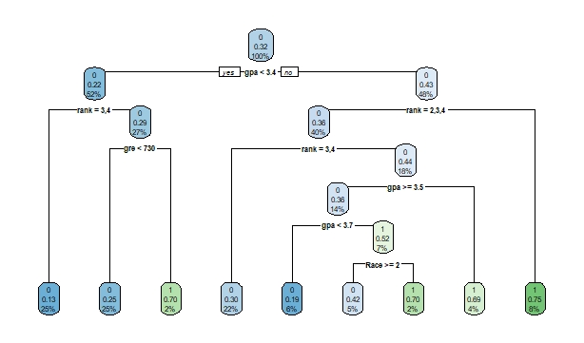
Decision Tree

Slide 14
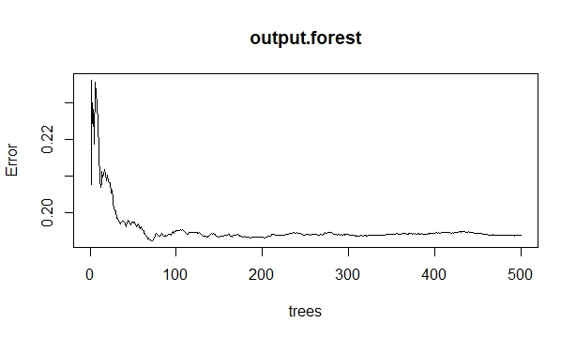
Random Forest

Slide 15
Conclusions
As We can see from execution of all models like linear , logistic ,decision tree and random forest
Random forest gives better results.
Also Rank and Grad are most influencing variables that affects on admission of students.

